Slide 1
Intro to R & H2O
By: Spencer Aiello

Slide 2

Agenda
short, short history of R
what is h2o
getting h2o and reading documentation
data exploration
model building

Slide 3
Getting H2O & Docs
http://h2o.ai/download/
Bleeding Edge (link)
Install in R (tab)
build h2o (https://github.com/h2oai/h2o-3#4-building-h2o-3)
http://docs.h2o.ai/ -> H2O 3.0 -> R Users (link) -> R docs (link)

Slide 4
A Brief History of R:
R first appears 22 years ago (1993)*
Implementation of S (which was created by John Chambers @ Bell Labs)
* Python first appeared 24 years ago (1991)

Slide 5
H2O is what exactly?
Services:
Interfaces to mainstream data science languages (R, Python, Scala)
I/O common data formats (CSV, zipped, HDFS, ORC, parquet!?)
Interface with modern big data infrastructures: Hadoop, Spark, H2O
Feature-generation capabilities
High Performance State-of-the-Art Machine Learning Algorithms

Slide 6
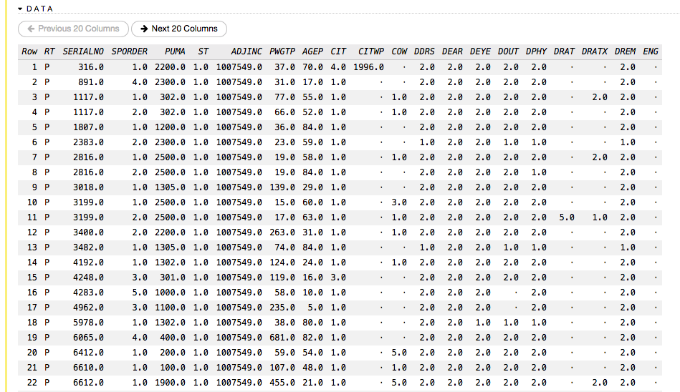
H2O is what exactly?
Object Taxonomy in H2O
H2OFrame: A 2D collection of uniformly typed columns
H2OModel: An H2O model object
ID/Key: An identifier for an H2O object

Slide 7
H2O is what exactly?
Feature Generation Capabilities
> 100 operations to perform on an H2OFrame
Aggregations:
mean, min, max, sum, or any user-defined reduction
distributed parallel group-by
table, cut
Simple String manipulation: trim, sub, gsub
Date Formatting/Extraction: get/set timezones, month, year, dayOfWeek
Transformations: sqrt, log, *,+, …
Filtering: R-like slicing

Slide 8
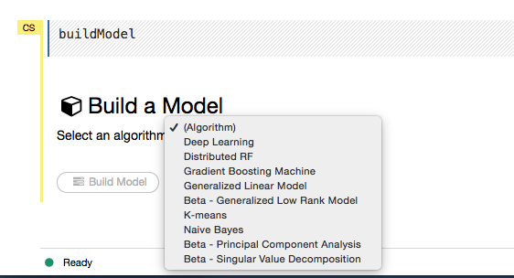
H2O is what exactly?
H2O Modeling

Slide 9
H2O is what exactly?
Infrastructure for:
KFold Cross-Validation
Grid Search
Model Import/Export

Slide 10
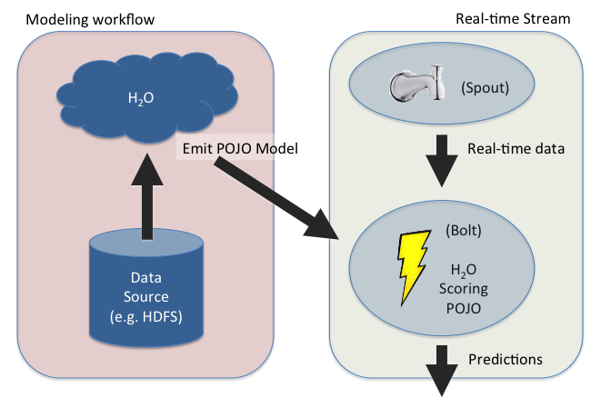
H2O is what exactly?
Export Models For Real-Time Scoring:

Slide 11



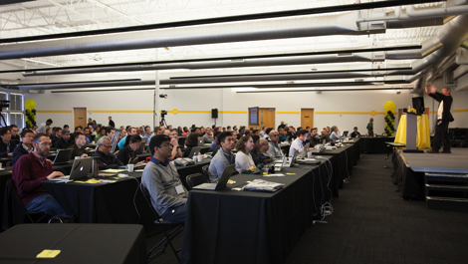
Team@H2O.ai
25,000 commits / 3yrs
H2O World Conference 2014

Slide 12
Driving H2O From R
STEP 2
2.3
Initiate distributed ingest
H2O Cluster
2.2
R
H₂O
HTTP REST API request to H₂O
H₂O
h2o.importFile()
H₂O
2.1
R function call
2.4
Request data
Some Data Location
data.csv
Notes:
Data never goes into or through R
R tells H2O what to do
R has a pointer to the big data that lives in H2O
Operations on the R object are intercepted using operator overleading and forwarded to H2O via the REST API
H2OFrame object in R is a proxy for the big data in H2O
R: df= H2O.imporrtFile(“hdfs://path/to/data.csv”)
h2o>_df is an H2OFrame object in R

Slide 13
Driving H2O From R
STEP 3
3.2
Distributed H₂O
Frame in DKV
H2O Cluster
3.3
R
H₂O
h2o_df
Return pointer to data in REST API JSON Response
H₂O
H₂O
Frame
Cluster IP
Cluster Port
Pointer to Data
H₂O
3.4
h2o_df object created in R
3.1
data provided
Some data
location
data.csv
Notes:
Data never goes into or through R
R tells H2O what to do
R has a pointer to the big data that lives in H2O
Operations on the R object are intercepted using operator overleading and forwarded to H2O via the REST API
H2OFrame object in R is a proxy for the big data in H2O
R: df= H2O.imporrtFile(“hdfs://path/to/data.csv”)
h2o>_df is an H2OFrame object in R

Slide 14
R Script Starting H2O GLM
TCP/IP
HTTP
HTTP
REST/JSON
REST/JSON
Legend
.h2o.startModelJob()
POST /3/ModelBuilders/glm
/3/ModelBuilders/glm endpoint
Network layer
Job
REST layer
h2o.glm()
GLM algorithm
H2O - algos
GLM tasks
H2O - core
R script
Fork/Join framework
K/V store framework
User process
Standard R process
H2O process
H2O process

Slide 15
R Script Retrieving H2O GLM Result
TCP/IP
HTTP
HTTP
REST/JSON
REST/JSON
Legend
h2o.getModel()
GET /3/Models/glm_model_id
/3/Models endpoint
Network layer
REST layer
h2o.glm()
H2O - algos
H2O - core
R script
Fork/Join framework
K/V store framework
User process
Standard R process
H2O process
H2O process

